Slide 1

6TH SEMESTER - COMPUTER GRAPHICS AND VISUALIZATION (18CS62) MODULE-3 CLIPPING, 3D GEOMETRIC TRANSFORMATIONS ,COLOR AND ILLUMINATION MODELS
SYED MATHEEN PASHA
Assistant professor
DEPARTMENT OF COMPUTER SCIENCE AND ENGINEERING
SAI VIDYA INSTITUTE OF TECHNOLOGY

Slide 2
CLIPPING
Clipping is the process of removing lines or portions of lines outside an area of interest.
Typically any line or part there of which is outside of the viewing area is removed.

Slide 3
2D Clipping
1. Introduction:
A scene is made up of a collection of objects specified in world coordinates
World Coordinates

Slide 4
2D Clipping
When we display a scene only those objects within a particular window are displayed
Window
wymax
wymin
wxmin
World Coordinates
wxmax

Slide 5
2D Clipping
Because drawing things to a display takes time we clip everything outside the window
Window
wymax
wymin
wxmin
wxmax
World Coordinates

Slide 6
2D Clipping
1.1 Definition:
Clipping is the process of determining which elements of the picture lie inside the window and are visible.
By default, the “clip window” is the entire canvas
not necessary to draw outside the canvas
for some devices, it is damaging (plotters)
\
Sometimes it is convenient to restrict the “clip window” to a smaller portion of the canvas
partial canvas redraw for menus, dialog boxes, other obscuration

Slide 7
2D Clipping
1.2 Shielding:
Shielding or exterior clipping is the reverse operation of clipping where window act as the block used to abstract the view.
Examples
A multi view window system
The design of page layouts in advertising or publishing applications or for adding labels or design patterns to picture.
Combining graphs, maps o schematics

Slide 8
2D Clipping
Window
wymax
wymin
wxmin
World Coordinates
wxmax

Slide 9
2D Clipping
1.3 Example:
For the image below consider which lines and points should be kept and which ones should be clipped against the clipping window
P4
Window
P2
wymax
P3
P6
P1
P7
P5
P9
P8
wymin
P10
wxmin
wxmax

Slide 10
2D Clipping
1.4 Applications:
Extract part of a defined scene for viewing.
Drawing operations such as erase, copy, move etc.
Displaying multi view windows.
Creating objects using solid modeling techniques.
Anti-aliasing line segments or object boundaries.
Identify visible surfaces in 3D views.

Slide 11
2D Clipping
1.5 Types of clipping:
Three types of clipping techniques are used depending upon when the clipping operation is performed
a. Analytical clipping
Clip it before you scan convert it
used mostly for lines, rectangles, and polygons, where clipping algorithms are simple and efficient

Slide 12
2D Clipping
b. Scissoring
Clip it during scan conversion
a brute force technique
scan convert the primitive, only write pixels if inside the clipping region
easy for thick and filled primitives as part of scan line fill
if primitive is not much larger than clip region, most pixels will fall inside
can be more efficient than analytical clipping.

Slide 13
2D Clipping
c. Raster Clipping
Clip it after scan conversion
render everything onto a temporary canvas and copy the clipping region
wasteful, but simple and easy,
often used for text

Slide 14
2D Clipping
Foley and van Dam suggest the following:
for floating point graphics libraries, try to use analytical clipping
for integer graphics libraries
analytical clipping for lines and polygons
others, do during scan conversion
sometimes both analytical and raster clipping performed

Slide 15
Clipping window
Clipping window
yw_{max}
yw_{max} − yw_{min}
yw_{min}
xw_{min}
xw_{max}
xw_{max}− xw_{min}
Clipping window usually an axis-aligned rectangle
Sometimes rotation
From world to view coordinates:
possibly followed by rotation
More complex in 3D
H&B 8-2:259-261

Slide 16
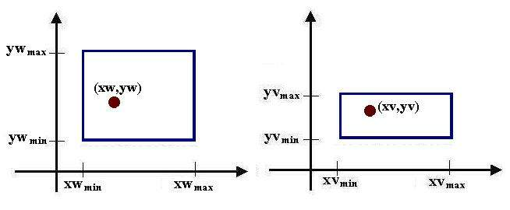
Window to Viewport Coordinate Transformation
Select the viewport in normalized coordinate, and then object description transferred to normalized device coordinate.
To maintain the same relative placement in the viewport as in the window:

Slide 17
Window to Viewport Coordinate Transformation
Perform a scaling transformation that scales the window area to the size of the viewport.
Translate the scaled window area to the position of the viewport.

Slide 18
2D Clipping
1.6 Levels of clipping:
Point Clipping
Line Clipping
Polygon Clipping
Area Clipping
Text Clipping
Curve Clipping

Slide 19
Point Clipping
Simple and Easy
a point (x,y) is not clipped if:
wx_{min} ≤ x ≤ wx_{max}
&
wy_{min} ≤ y ≤ wy_{max}
otherwise it is clipped
P4
Clipped
Clipped
Window
P2
wymax
Clipped
P5
P7
P1
Points Within the Window are Not Clipped
P9
P8
wymin
Clipped
P10
wxmin
wxmax

Slide 20
Line Clipping
It is Harder than point clipping
We first examine the end-points of each line to see if they are in the window or not
Both endpoints inside, line trivially accepted
One in and one out, line is partially inside
Both outside, might be partially inside
What about trivial cases?
ymax
ymin
xmin
xmax

Slide 21
Line Clipping
Situation | Solution | Example
Both end-points inside the window | Don’t clip
One end-point inside the window, one outside | Must clip
Both end-points outside the window | Don’t know!

Slide 22
2D Line Clipping Algorithms
Analytical Line Clipping
Cohen Sutherland Line Clipping
Liang Barsky Line Clipping

Slide 23
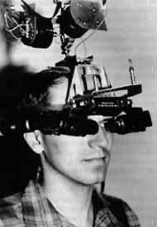

Cohen-Sutherland Line Clipping
An efficient line clipping algorithm
The key advantage of the algorithm is that it vastly reduces the number of line intersections that must be calculated.
Dr. Ivan E. Sutherland co-developed the Cohen-Sutherland clipping algorithm. Sutherland is a graphics giant and includes amongst his achievements the invention of the head mounted display.
Cohen is something of a mystery – can anybody find out who he was?

Slide 24
Cohen-Sutherland Line Clipping
Two phases Algorithm
Phase I: Identification Phase
All line segments fall into one of the following categories
Visible: Both endpoints lies inside
Invisible: Line completely lies outside
Clipping Candidate: A line neither in category 1 or 2
Phase II: Perform Clipping
Compute intersection for all lines that are candidate for clipping.

Slide 25
Cohen-Sutherland Line Clipping
Phase I: Identification Phase: World space is divided into regions based on the window boundaries
Each region has a unique four bit region code
Region codes indicate the position of the regions with respect to the window
1001 | 1000 | 1010
0001 | 0000 Window | 0010
0101 | 0100 | 0110
3
2
1
0
above
below
right
left
Region Code Legend

Slide 26
Cohen-Sutherland Line Clipping
Every end-point is labelled with the appropriate region code
P11 [1010]
P4 [1000]
Window
wymax
P6 [0000]
P3 [0001]
P5 [0000]
P12 [0010]
P7 [0001]
P9 [0000]
P8 [0010]
wymin
P10 [0100]
P13 [0101]
P14 [0110]
wxmin
wxmax

Slide 27
Cohen-Sutherland Line Clipping
Visible Lines: Lines completely contained within the window boundaries have region code [0000] for both end-points so are not clipped
P11 [1010]
P4 [1000]
Window
wymax
P6 [0000]
P3 [0001]
P5 [0000]
P12 [0010]
P7 [0001]
P9 [0000]
P8 [0010]
wymin
P10 [0100]
P13 [0101]
P14 [0110]
wxmin
wxmax

Slide 28
Cohen-Sutherland Line Clipping
Invisible Lines: Any line with a common set bit in the region codes of both end-points can be clipped completely
The AND operation can efficiently check this
Non Zero means Invisible
P11 [1010]
P4 [1000]
Window
wymax
P6 [0000]
P3 [0001]
P5 [0000]
P12 [0010]
P7 [0001]
P9 [0000]
P8 [0010]
wymin
P10 [0100]
P13 [0101]
P14 [0110]
wxmin
wxmax

Slide 29
Cohen-Sutherland Line Clipping
Clipping Candidates: Lines that cannot be identified as completely inside or outside the window may or may not cross the window interior. These lines are processed in Phase II.
If AND operation result in 0 the line is candidate for clipping
P11 [1010]
P4 [1000]
Window
wymax
P6 [0000]
P3 [0001]
P5 [0000]
P12 [0010]
P7 [0001]
P9 [0000]
P8 [0010]
wymin
P10 [0100]
P13 [0101]
P14 [0110]
wxmin
wxmax

Slide 30
Cohen-Sutherland Line Clipping
Assigning Codes
Let point (x,y) is be given code b₃b₂b₁b₀:
bit 3 = 1 if wy_{max} - y ≤0
bit 2 = 1 if y - wy_{min} ≤ 0
bit 1 = 1 if wx_{max} - x ≤0
bit 0 = 1 if x - wx_{min} ≤ 0
P4 [1000]
P11 [1010]
Window
wymax
P3 [0001]
P6 [0000]
P5 [0000]
P12 [0010]
P7 [0001]
P9 [0000]
P8 [0010]
wymin
P13 [0101]
P10 [0100]
P14 [0110]
wxmin
wxmax

Slide 31
Cohen-Sutherland Clipping Algorithm
Phase II: Clipping Phase: Lines that are in category 3 are now processed as follows:
Compare an end-point outside the window to a boundary (choose any order in which to consider boundaries e.g. left, right, bottom, top) and determine how much can be discarded
If the remainder of the line is entirely inside or outside the window, retain it or clip it respectively
Otherwise, compare the remainder of the line against the other window boundaries
Continue until the line is either discarded or a segment inside the window is found

Slide 32
Cohen-Sutherland Line Clipping
Intersection points with the window boundaries are calculated using the line-equation parameters
Consider a line with the end-points (x₁, y₁) and (x₂, y₂)
The y-coordinate of an intersection with a vertical window boundary can be calculated using:
y = y₁ + m (x_{boundary} - x₁)
where x_{boundary} can be set to either wx_{min} or wx_{max}
The x-coordinate of an intersection with a horizontal window boundary can be calculated using:
x = x₁ + (y_{boundary} - y₁) / m
where y_{boundary} can be set to either wy_{min} or wy_{max}

Slide 33
Cohen-Sutherland Line Clipping
We can use the region codes to determine which window boundaries should be considered for intersection
To check if a line crosses a particular boundary we compare the appropriate bits in the region codes of its end-points
If one of these is a 1 and the other is a 0 then the line crosses the boundary.

Slide 34
Cohen-Sutherland Line Clipping
Example1: Consider the line P₉ to P₁₀ below
Start at P₁₀
From the region codes of the two end-points we know the line doesn’t cross the left or right boundary
Calculate the intersection of the line with the bottom boundary
to generate point P₁₀’
The line P₉ to P₁₀’ is completely inside the window so is retained
Window
wymax
P9 [0000]
P9 [0000]
wymin
P10’ [0000]
P10 [0100]
wxmin
wxmax

Slide 35
Cohen-Sutherland Line Clipping
Example 2: Consider the line P₃ to P₄ below
Start at P₄
From the region codes of the two end-points we know the line crosses the left boundary so calculate the intersection point to generate P₄’
The line P₃ to P₄’ is completely outside the window so is clipped
P4’ [1001]
P4 [1000]
Window
wymax
P3 [0001]
P3 [0001]
wymin
wxmin
wxmax

Slide 36
Cohen-Sutherland Line Clipping
Example 3: Consider the line P₇ to P₈ below
Start at P₇
From the two region codes of the two end-points we know the line crosses the left boundary so calculate the intersection point to generate P₇’
Window
wymax
P7’ [0000]
P7 [0001]
P8 [0010]
P8’ [0000]
wymin
wxmin
wxmax

Slide 37
Cohen-Sutherland Line Clipping
Example 4: Consider the line P₇’ to P₈
Start at P₈
Calculate the intersection with the right boundary to generate P₈’
P₇’ to P₈’ is inside the window so is retained
Window
wymax
P7’ [0000]
P7 [0001]
P8 [0010]
P8’ [0000]
wymin
wxmin
wxmax

Slide 38
Cohen-Sutherland Line Clipping
Mid-Point Subdivision Method
Algorithm
Initialise the list of lines to all lines
Classify lines as in Phase I
Assign 4 point bit codes to both end points a₃a₂a₁a₀ and b₃b₂b₁b₀
If (a₃a₂a₁a₀ = b₃b₂b₁b₀ = 0 )Line in category 1
If (a₃a₂a₁a₀)AND (b₃b₂b₁b₀ ) # 0 ) Line in category 2
If (a₃a₂a₁a₀)AND (b₃b₂b₁b₀ ) = 0 ) Line in category 3
Display all lines from the list in category 1 and remove;
Delete all lines from the list in category 2 as they are invisible;
Divide all lines of category 3 are into two smaller segments at mid-point (x_{m},y_{m}) where x_{m} = (x₁ +x₂)/2 and y_{m} = (y₁ +y₂)/2
Remove the original line from list and enter its two newly created segments.
Repeat step 2-5 until list is null.

Slide 39
Cohen-Sutherland Line Clipping
Window
wymax
wymin
wxmin
wxmax

Slide 40
Cohen-Sutherland Line Clipping
Window
wymax
wymin
wxmin
wxmax

Slide 41
Cohen-Sutherland Line Clipping
Mid-Point Subdivision Method
Integer Version
Fast as Division by 2 can be performed by simple shift right operation
For NxN max dimension of line number of subdivisions required log₂ N.
Thus a 1024x1024 raster display require just 10 subdivisions………

Slide 42
Polygon Clipping
Polygons have a distinct inside and outside…
Decided by
Even/Odd
Winding Number
Notes:
Note that even/odd makes the inside of the star empty. Winding number does not. The winding number is counted by noting the number of line segments crossed and the direction of the crossing. The direction is created by walking around the edges in clockwise (or ccw) fashion. Each line segment is given a direction by this walk. Then, when deciding if a point is inside or out, you count the number of right→left crossings and left→right crossings. If they are equal, you are outside. Otherwise, you are inside.

Slide 43
Polygon Clipping
Note the difference between clipping lines and polygons:
NOTE!
Notes:
NOTE! Some clipping algorithms leave the pieces connected by a line, others do not. The major difference is that you want to know what is inside and what is outside of the polygon.

Slide 44
Polygon Clipping
Some difficulties:
Maintaining correct inside/outside
Variable number of vertices
Handle screen corners
correctly

Slide 45

Sutherland-Hodgman Area Clipping
A technique for clipping areas developed by Sutherland & Hodgman
Put simply the polygon is clipped by comparing it against each boundary in turn
Sutherland turns up again. This time with Gary Hodgman with whom he worked at the first ever graphics company Evans & Sutherland
Original Area
Clip Left
Clip Right
Clip Top
Clip Bottom

Slide 46
Sutherland-Hodgeman Polygon Clipping
1. Basic Concept:
Simplify via separation
Clip whole polygon against one edge
Repeat with output for other 3 edges
Similar for 3D
You can create intermediate vertices that get thrown out

Slide 47
Sutherland-Hodgeman Polygon Clipping
Example
Start
Left
Right
Bottom
Top
Note that the point one of the points added when clipping
on the right gets removed when we clip with bottom

Slide 48
Sutherland-Hodgeman Polygon Clipping
2. Algorithm:
Let (P₁, P₂,…. P_{N}) be the vertex list of the Polygon to be clipped and E be the edge of +vely oriented, convex clipping window.
We clip each edge of the polygon in turn against each window edge E, forming a new polygon whose vertices are determined as follows:

Slide 49
Sutherland-Hodgeman Polygon Clipping
Four cases
Inside: If both P_{i-1} and P_{i} are to the left of window edge vertex then P_{i} is placed on the output vertex list.
Entering: If P_{i-1} is to the right of window edge and P_{i} is to the left of window edge vertex then intersection (I) of P_{i-1} P_{i} with edge E and P_{i} are placed on the output vertex list.
Leaving: If P_{i-1} is to the left of window edge and P_{i} is to the right of window edge vertex then only intersection (I) of P_{i-1} P_{i} with edge E is placed on the output vertex list.
Outside: If both P_{i-1} and P_{i} are to the right of window edge nothing is placed on the output vertex list.

Slide 50
Sutherland-Hodgeman Polygon Clipping
Creating New Vertex List
Pi-1
Pi
Pi
Pi-1
Pi
Pi-1
Pi
Pi-1
in → in
save ending vert
Inside
(1 output)
out → in
save new clip vert
and ending vert
Entering
(2 outputs)
in → out
save new clip vert
Leaving
(1 output)
out → out
save nothing
Outside
(0 output)

Slide 51
Sutherland-Hodgman Polygon Clipping
Each example shows the point being processed (P) and the previous point (S)
Saved points define area clipped to the boundary in question
S
S
P
I
P
Save Point P
Save Point I
P
S
I
P
S
No Points Saved
Save Points I & P

Slide 52
Flow Chart
START
INPUT VERTEX LIST
(P1, P2........, PN)
FOR i =1 TO (N-1) DO
IF PiPi+1 INTERSECT E ?
YES
NO
COMPUTE I
OUTPUT I IN VERTEX LIST
YES
IF Pi TO LEFT OF E ?
NO
Special case for first Vertex
OUTPUT Pi IN VERTEX LIST
i = i+1

Slide 53
Flow Chart
Special case for first Vertex
IF PNP0 INTERSECT E ?
YES
NO
COMPUTE I
OUTPUT I IN VERTEX LIST
END
YOU CAN ALSO APPEND AN ADDITIONAL VERTEX PN+1 = P1 AND AVOID SPECIAL CASE FOR FIRST VERTEX

Slide 54
Sutherland-Hodgeman Polygon Clipping
Inside/Outside Test:
Let P(x,y) be the polygon vertex which is to be tested against edge E defined form A(x₁, y₁) to B(x₂, y₂). Point P is to be said to the left (inside) of E or AB iff
or C = (x₂ – x₁) (y – y₁) – (y₂ – y₁)(x – x₁) > 0
otherwise it is said to be the right/Outside of edge E

Slide 55
Other Area Clipping Concerns
Clipping concave areas can be a little more tricky as often superfluous lines must be removed
Clipping curves requires more work
For circles we must find the two intersection points on the window boundary
Window
Window
Window
Window

Slide 56
Text Clipping
Text clipping relies on the concept of bounding rectangle
TYPES
All or None String Clipping
All or None Character Clipping
Component Character Clipping

Slide 57
Text Clipping
1. All or None String Clipping
In this scheme, if all of the string is inside window, we clip it, otherwise the string is discarded. This is the fastest method.
The procedure is implemented by consider a bounding rectangle around the text pattern. The boundary positions are compared to the window boundaries. In case of overlapping the string is rejected.
STRING 5
STRI NG 1
STRING 2
STRING 3
STRING 4
STRING 4

Slide 58
Text Clipping
2. All or None Character Clipping
In this scheme, we discard only those characters that are not completely inside window.
Boundary limits of individual characters are compared against window. In case of overlapping the character is rejected.
STRING 5
STRI NG 1
NG 1
STRING 2
STRI
STRING 3
TRING 3
STRING 4
STRING 4

Slide 59
Text Clipping
3. Component Character Clipping
Characters are treated like graphic objects.
Bit Mapped Fonts : Point Clipping
Outlined Fonts : Line/Curve Clipping
In case of overlapping the part of the character inside is displayed and the outside portion of the character is rejected.
STRING 5
STRI NG 1
NG 1
STRING 2
STRIN
STRING 3
STRING 3
STRING 4
STRING 4

Slide 60
Curve Clipping
Areas with curved boundaries can be clipped with methods similar to line and polygon clipping.
Curve clipping requires more processing as it involve non linear equations.
Bounding Rectangles are used to test for overlap with rectangular clip window.

Slide 61
Curve Clipping
If bounding rectangle is completely inside the object/curve is saved.
If bounding rectangle is completely outside the object/curve is discarded.

Slide 62
Curve Clipping
If both the above tests fails we use other computation saving approaches depending upon type of object
Circle: Use coordinate extent of individual quadrant, then octant if required.
Ellipse: Use coordinate extent of individual quadrant.
Point: Use point clipping

Slide 63
3D Transformations.
Use homogeneous coordinates, just as in 2D case.
Transformations are now 4x4 matrices.
We will use a right-handed (world) coordinate system - ( z out of page ).
y
Note:
Convenient to think of display as
Being left-handed !!
( z into the screen )
x
z (out of page)

Slide 64
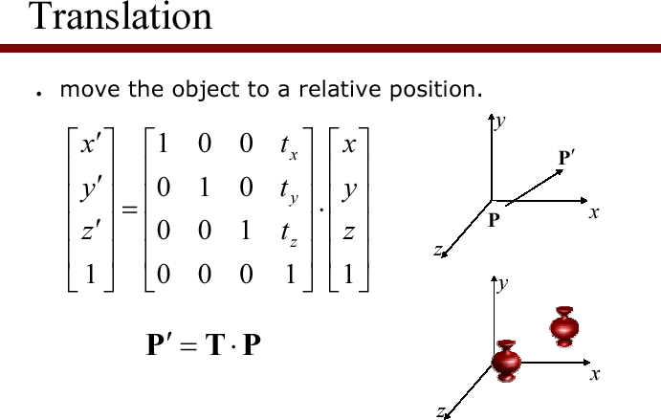
Simple extension to the 3D case:

Slide 65
Scale in 3D.
Simple extension to the 3D case:
⎡s_{x} 0 0 0⎤
⎢ 0 s 0
₀⎥
⎥
⎢ 0 0 s 0⎥
⎣ 0 0 0 1⎦
S (s , s , s ) = ⎢
y
x y z
⎢
z
⎥

Slide 66
Rotation in 3D
Need to specify which axis the rotation is about.
z-axis rotation is the same as the 2D case.
⎡cosθ
⎢sinθ
− sinθ 0 0⎤ cosθ 0
0 1
0 0
₀⎥
R_{z} (θ ) = ⎢
⎥
0⎥
⎢
0
0
⎢
₁⎥
⎣
⎦

Slide 67
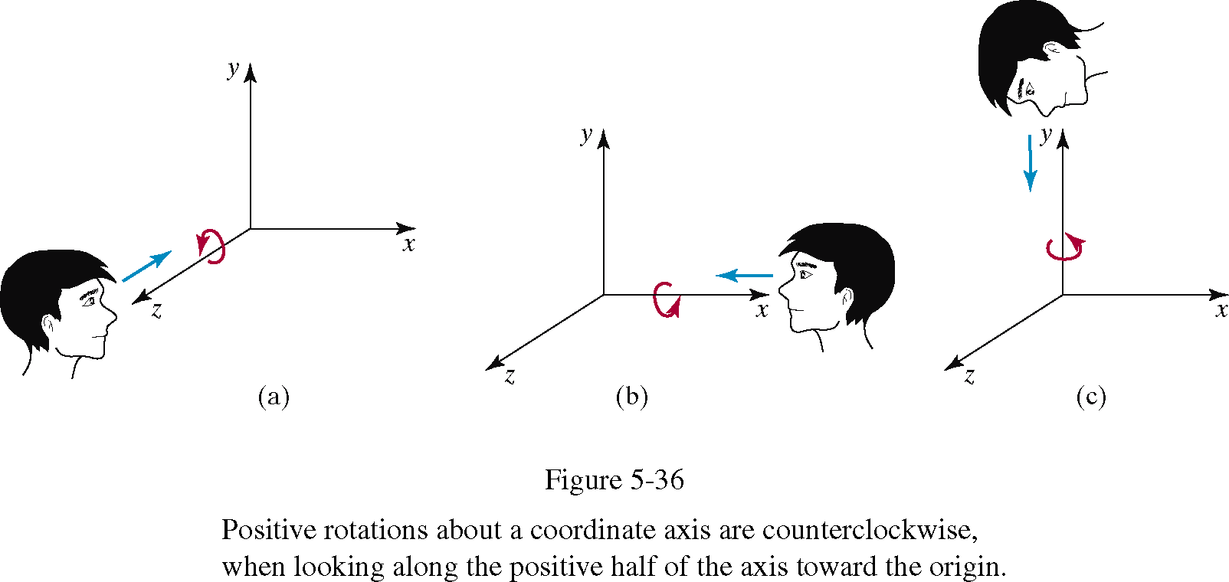

Slide 68
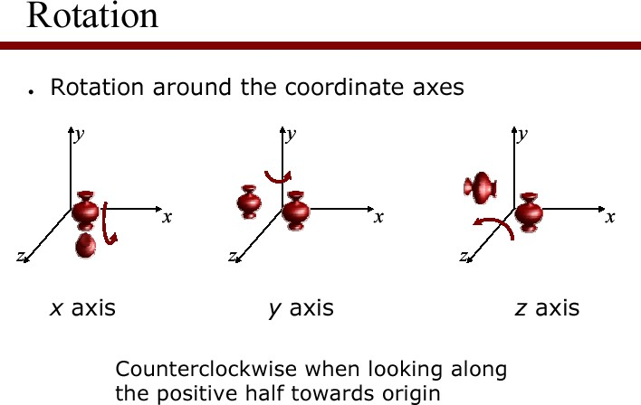

Slide 69
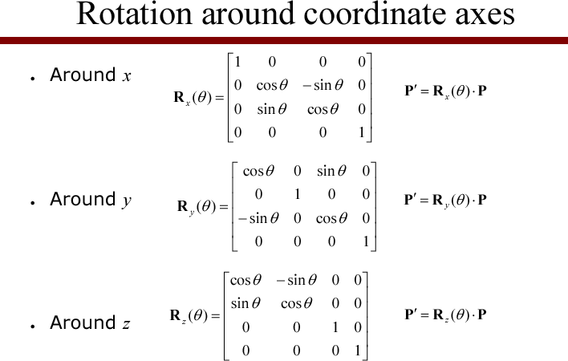

Slide 70
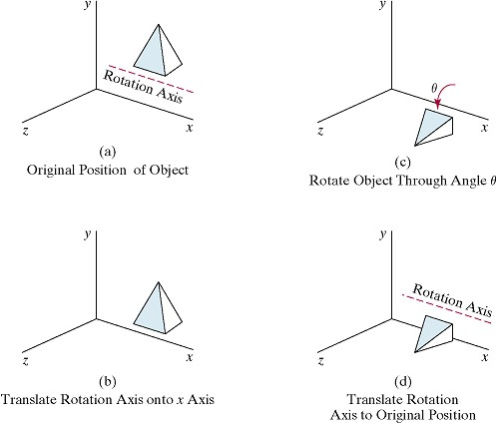
Rotation around an axis parallel to x-axis

Slide 71
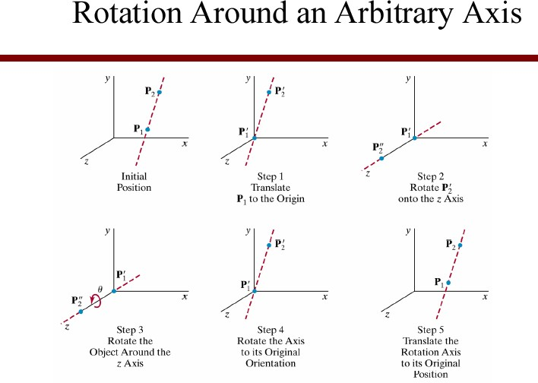

Slide 72
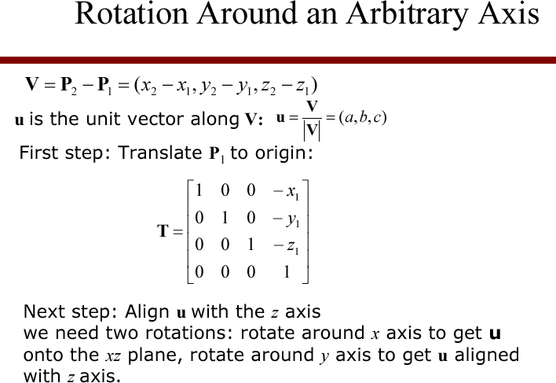

Slide 73
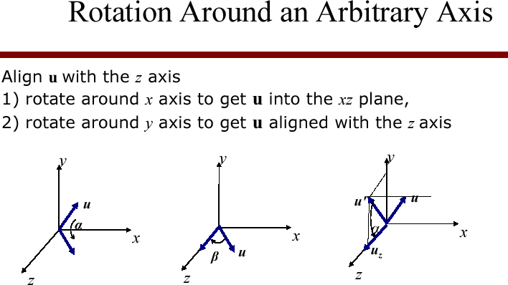

Slide 74
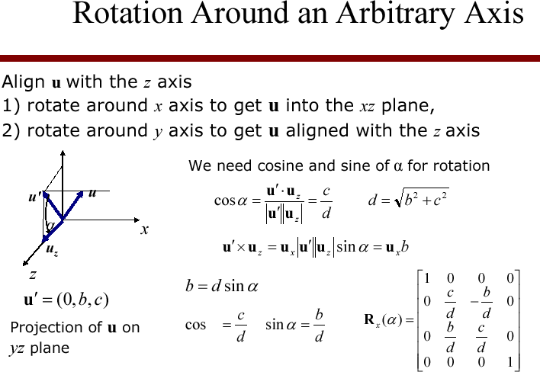
α

Slide 75
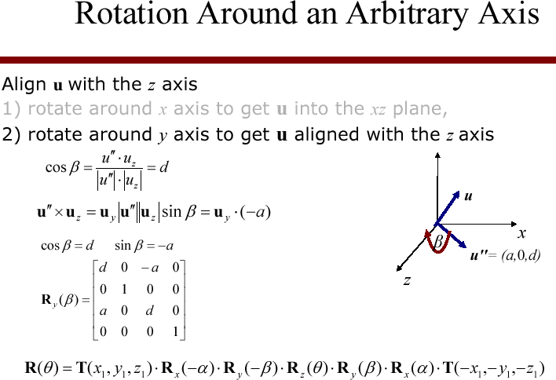

Slide 76
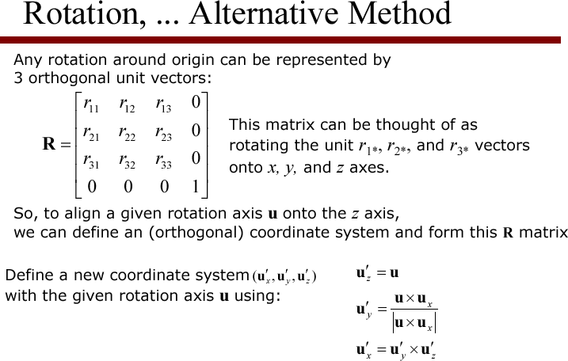

Slide 77
Rows of upper-left 3x3 submatrix, when rotated by R lie on the x,y and z axes
⎡r₁₁ ⎤ ⎡1⎤ ⎡r₂₁ ⎤ ⎡0⎤ ⎡r₃₁ ⎤ ⎡0⎤
⎢_{r} ⎥ ⎢₀⎥ ⎢_{r} ⎥ ⎢₁⎥ ⎢_{r} ⎥ ⎢₀⎥
_{R} ⎢ ¹² ⎥ ₌ ⎢ ⎥ _{R} ⎢ ²² ⎥ ₌ ⎢ ⎥ _{R} ⎢ ³² ⎥ ₌ ⎢ ⎥
⎢r₁₃ ⎥
⎢0⎥ ⎢r₂₃ ⎥
⎢0⎥ ⎢r₃₃ ⎥ ⎢1⎥
⎢ ₁ ⎥
⎢ ⎥ ⎢ ⎥
⎢ ⎥ ⎢ ⎥ ⎢ ⎥
⎣ ⎦ ⎣¹⎦ ⎣ ¹ ⎦
⎣¹⎦ ⎣ ¹ ⎦ ⎣¹⎦

Slide 78
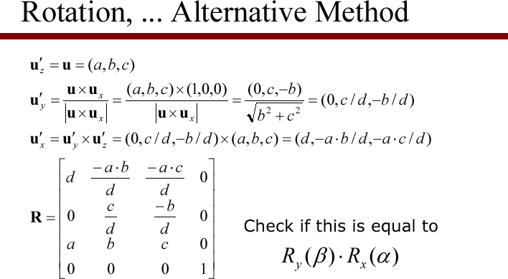

Slide 79
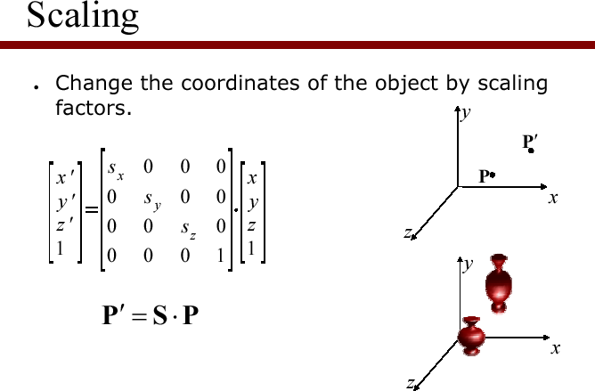
Scaling an object with this transformation will also move its position relative to the origin - so move it to the origin, scale it, then move it back...

Slide 80
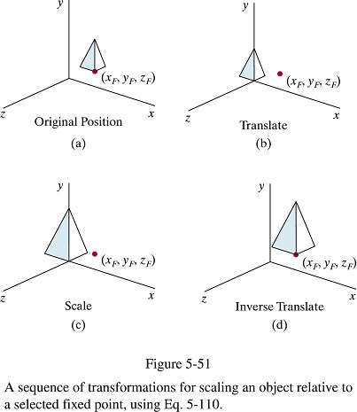

Slide 81
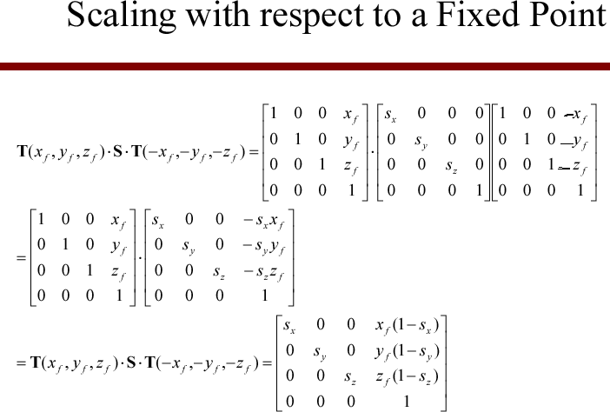

Slide 82
More 3D transformations
+/- same as in 2D:
Matrix concatenation by multiplication
Reflection
Shearing
Transformations between coordinate systems
H&B 9-4, 9-5, 9-6:319-324

Slide 83
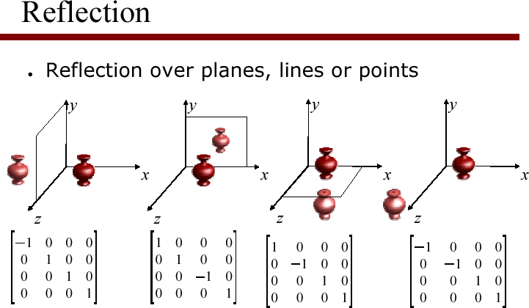

Slide 84
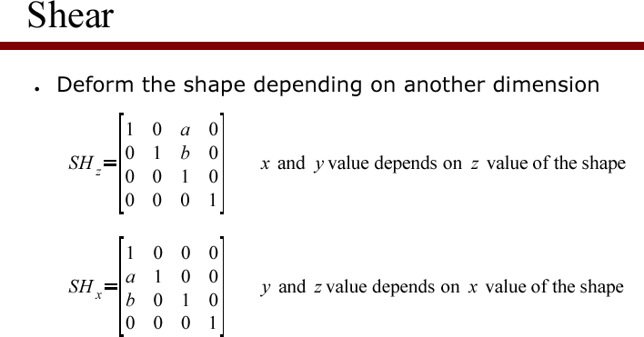

Slide 85
Affine transformations 1
Generic name for these transformations:
affine transformations
H&B 9-7:324

Slide 86
Affine transformations 2
Properties:
Transformed coordinates x’,y’ and z’ are linearly dependent on original coordinates x, y en z.
Parameters a_{ij} en b_{k} are constant and determine type of transformation;
Examples: translation, rotation, scaling, reflection
Parallel lines remain parallel
Only translation, rotation reflection: angles and lengths are maintained
H&B 9-7:324

Slide 87
Basic OpenGL Geometric Transformation Functions
A 4× 4 translation matrix is constructed with the following routine:
glTranslate* (tx, ty, tz);
» Translation parameters tx, ty, and tz can be assigned any real-number values, and the single suffix code to be affixed to this function is either f (float) or d (double).
» For two-dimensional applications, we set tz = 0.0; and a two-dimensional position is represented as
a four-element column matrix with component equal to 0.0.
» example: glTranslatef (25.0, -10.0, 0.0);
the z

Slide 88
Basic OpenGL Geometric Transformation Functions
Similarly, a 4 × 4 rotation matrix is generated with
glRotate* (theta, vx, vy, vz);
where the vector v = (vx, vy, vz) can have any floating-point values for its components.
This vector defines the orientation for a rotation axis that passes through the coordinate origin.
The suffix code can be either f or d, and parameter
theta is to be assigned a rotation angle in degree.
For example, the statement:
glRotatef (90.0, 0.0, 0.0, 1.0);

Slide 89
Basic OpenGL Geometric Transformation Functions
4 × 4 scaling matrix with respect to the coordinate origin with the following routine:
glScale* (sx, sy, sz);
The suffix code is again either f or d, and the scaling parameters can be assigned any real- number values.
Scaling in a two-dimensional system involves changes in the x and y dimensions, so a typical two-dimensional scaling operation has a z scaling factor of 1.0
Example: glScalef (2.0, -3.0, 1.0);
•

Slide 90
OpenGL Matrix Operations
The glMatrixMode routine is used to set the projection mode which designates the matrix that is to be used for the projection transformation
The modelview mode can be set
glMatrixMode (GL_MODELVIEW);
– which designates the 4×4 modelview matrix as the
current matrix
Two other modes that can be set with the
glMatrixMode function are the
texture mode color mode.

Slide 91
Basic OpenGL Geometric Transformation function
The texture matrix is used for mapping texture patterns to surfaces, and the color matrix is used to convert from one color model to another.
The default argument for the glMatrixMode function is GL_MODELVIEW.
With the following function, we assign the identity matrix to the current matrix:
glLoadIdentity ( );
Alternatively, we can assign other values to the elements of the current matrix using
glLoadMatrix* (elements16);
A single-subscripted, 16-element array of floating-point values is specified with parameter

Slide 92
COLOR MODELS

Slide 93
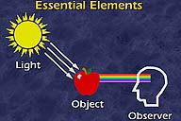
What is Color
The property possessed by an object of producing different sensations on the eye as a result of the way it reflects or emits light.
To see color, three essential elements must be present:
light
an illuminated object
and an observer

Slide 94
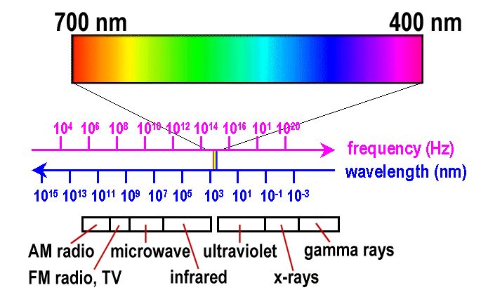
Properties of light
What is light?
“light” = narrow frequency band of electromagnetic spectrum
The Electromagnetic Spectrum
Red: 3.8x10¹⁴ hertz
Violet: 7.9x10¹⁴ hertz
We perceive electromagnetic energy having wavelengths in the range 400-700 nm as visible light.

Slide 95
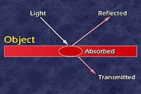
Properties of light
When light strikes an object, wavelengths may be reflected, absorbed or transmitted.
Colorants can be mixed to control the wavelengths and colors we see.

Slide 96
Visible light is an electromagnetic wave in the range 400-700 nm
Violet light
Red light

Slide 97
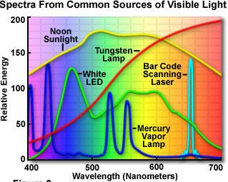
Properties of light
Monochrome light can be described by frequency f and wavelength λ
c = λ f (c = speed of light)
Normally, a ray of light contains many different waves with individual frequencies
The associated distribution of wavelength intensities per wavelength is referred to as the spectrum of a given ray or light source

Slide 98
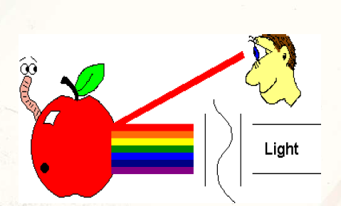
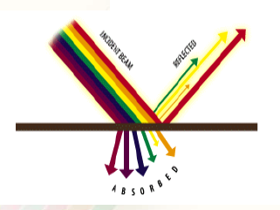
Properties of light
A light source such as the sun or a standard household light bulb emits all frequencies
within the visible range to produce white light.
When white light is incident upon an opaque object, some frequencies are reflected and
some are absorbed.

Slide 99
Properties of light
The frequency ( or mix of frequencies ) of the light determines the color.
The amount of light(sheer quantity of photons ) is the intensity.
Three independent quantities are used to describe any particular color. : hue, saturation, and lightness or brightness or intensity.

Slide 100
Psychological Characteristics of Color
Dominant Frequency (Hue) The color we see (red, green, purple).
Brightness
The total light energy, how bright is the color (How bright are the lights illuminating the object?)
Purity (Saturation)
Purity describes how close a light appears to be to a pure spectral color, such as pink is less saturated than red.

Slide 101

Psychological Characteristics of Color
When we call an object "red," we are referring to its hue. Hue is determined by the dominant wavelength.

Slide 102
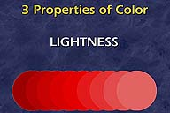
Psychological Characteristics of Color
Lightness or brightness refers to the amount of light the color reflects or transmits.
Intensity is determined by the actual amount of light, with more light corresponding to more intense colors ( the total light across all frequencies).

Slide 103
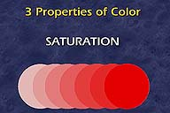
Psychological Characteristics of Color
The saturation of a color ranges from neutral to brilliant.
The circle on the right is a more vivid red than the circle on the left although both have the same hue.
The saturation is determined by the excitation purity , and depends on the amount of white light mixed with the hue.
A pure hue is fully saturated, i.e. no white light mixed in. Hue and saturation together determine the chromaticity for a given color.

Slide 104
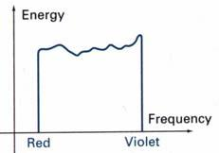
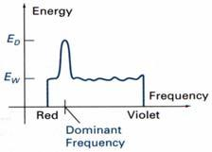
Psychological Characteristics of Color
Dominant frequency (hue, color)
Brightness (area under the curve), total light energy
Purity (saturation), how close a light appear to be a pure spectral color, such as red
Purity = E_{D} − E_{W}
E_{D} = dominant energy density
E_{W} = white light energy density

Slide 105
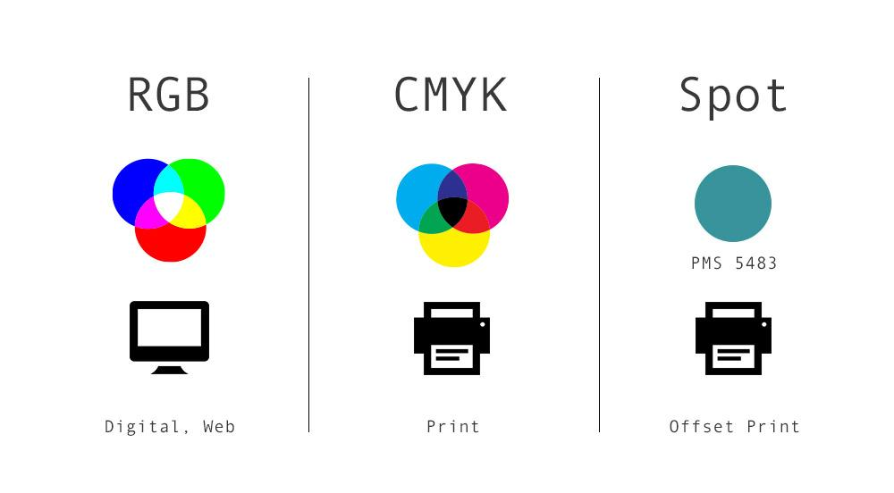
Color Model
Any method for explaining the properties or behavior of color within some particular context is called a Color Model

Slide 106

Color Model
Primary Colors
If the three colors of light can be mixed to produce white, they are called primary colors
and the standard additive primary colors are red, green and blue.

Slide 107
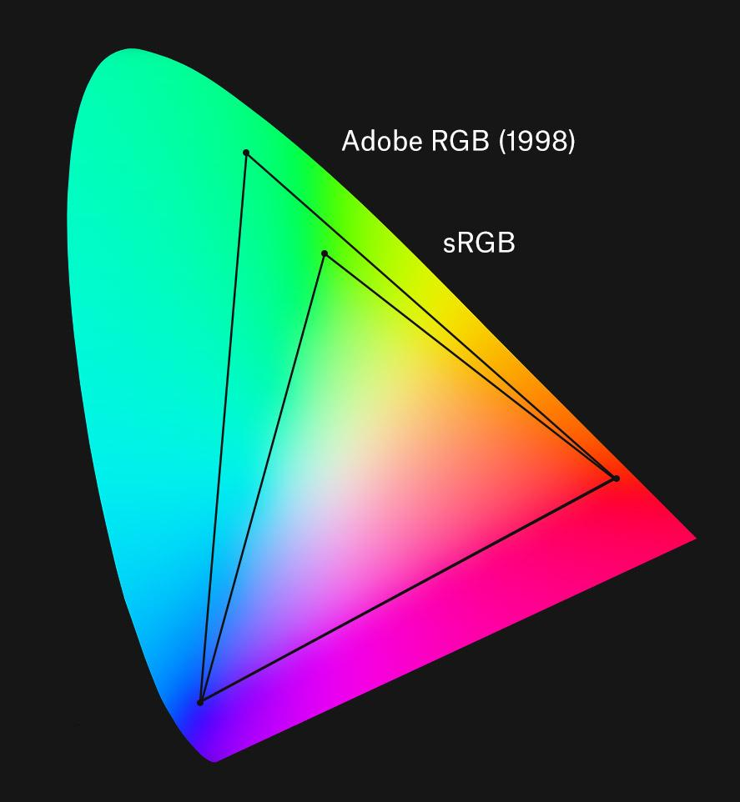
Color Model
Color Gamut
Set of all colors that we can produce from the primary colors.

Slide 108
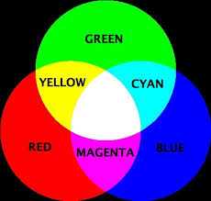
Color Model
Complementary Colors
Two primaries colors, when combined in the right proportions,
produce white.
Example, in the RGB model:
red & cyan ,
green & magenta , blue & yellow.

Slide 109
Intuitive Color Concepts
Color mixing created by an artist
Shades, tints and tones in scene can be produced by mixing color pigments (hues) with white and black pigments
Shades
Add black pigment to pure color
The more black pigment, the darker the shade
Tints
Add white pigment to the original color
Making it lighter as more white is added
Tones
Produced by adding both black and white pigments

Slide 110
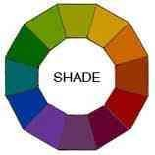
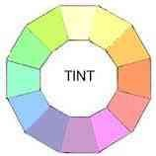
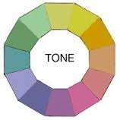
Intuitive Color Concepts
Shades , Tints & Tones
A shade is produced by “dimming ” a hue.[Adding black].
Dark Blue = pure blue + black
A tint is produced by "lightening" a hue. [Adding white].
Pastel red = pure red + white
Tone refers to the effects of reducing the "colorfulness" of a hue. [adding gray] or [adding black & white].
Thus, shading takes a hue toward black, tinting takes a hue
towards white, and tones cover the range between.

Slide 111
There are two types of color models
Additive color models
Colors perceived in additive models are the result of transmitted light.
use light to display color
Subtractive models
Colors perceived in subtractive models are the result of reflected light.
subtractive models use printing inks.

Slide 112
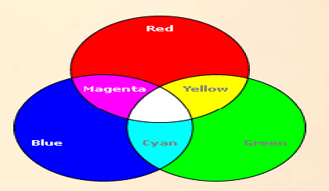


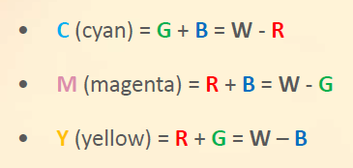

Slide 113
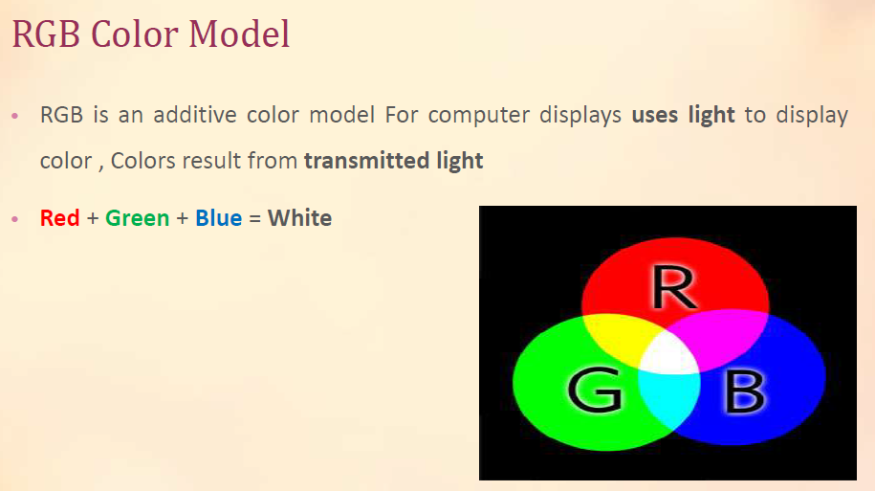

Slide 114
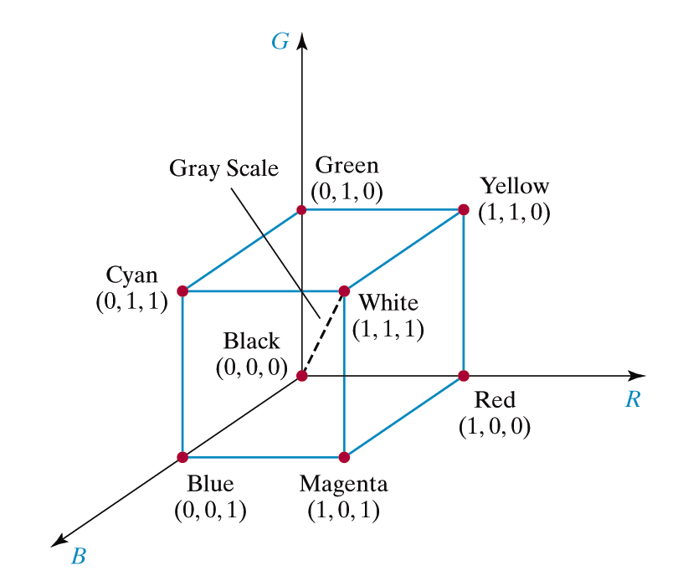
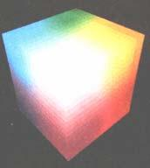
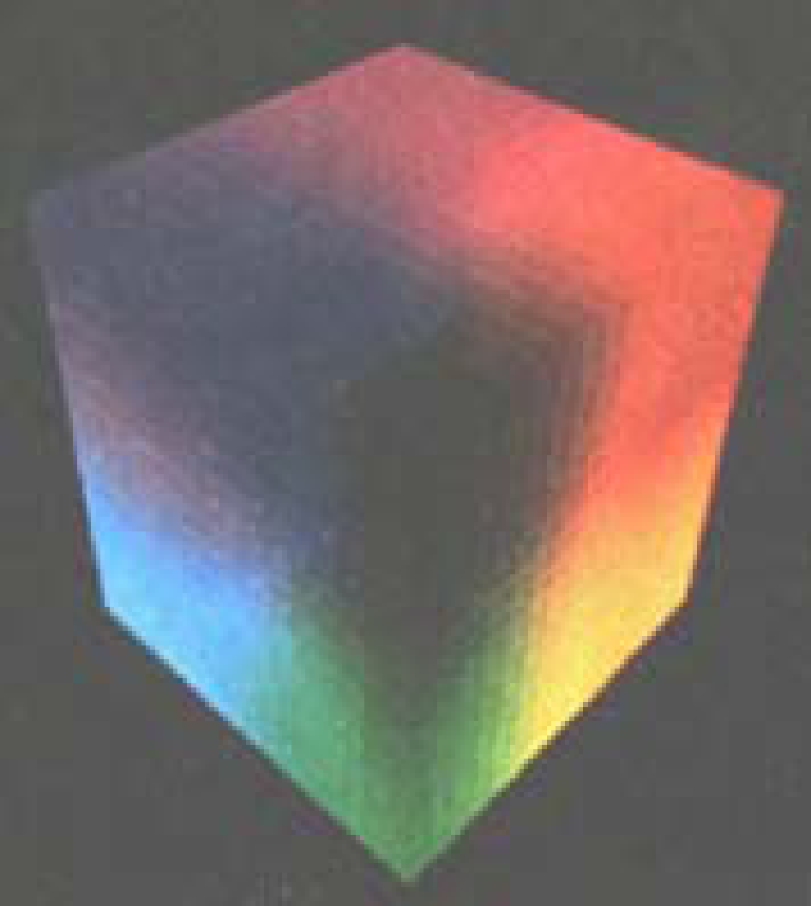
The RGB Color Model
Basic theory of RGB color model
The tristimulus theory of vision
It states that human eyes perceive color through the stimulation of three visual pigment of the cones of the retina
Red, Green and Blue
Model can be represented by the unit cube defined on R,G and B axes

Slide 115
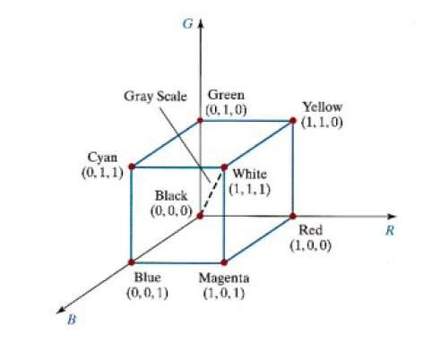
RGB Model
The red, green, and blue (RGB) color space is
widely used throughout computer graphics.
Additive Color Model.
Unit Cube defined on R, G & B axes.
The Origin (0,0,0) represents black and the diagonally opposite vertex (1,1,1) is White.
Vertices of the cube on the axes represent primary colors, and the remaining vertices are the complementary color points for each of the primary colors.
Shades of gray are represented along the main diagonal.

Slide 116
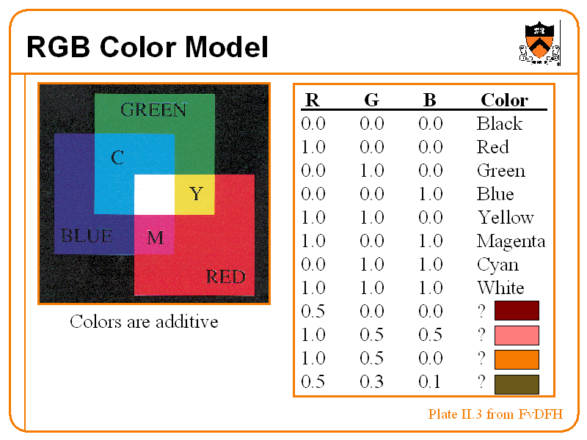

Slide 117
RGB Model
Each color point within the unit cube can be represented as w weighted vector sum of the primary colors, using unit vectors R,G and B.
C(λ) =(R,G,B) = RR +GG+ BB
Where R,G, and B are assigned values in the range from
0 to 1.0.
For example , the magenta vertex is obtained by adding the
maximum red and blue values to produce : (1,0,1)

Slide 118
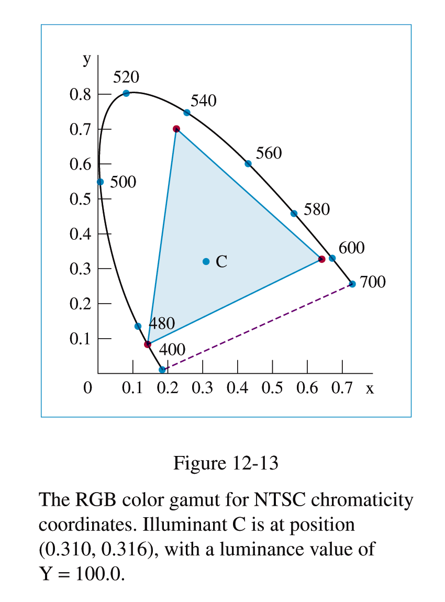
The RGB Color Model
Chromaticity coordinates for the National Television System Committee (NTSC) standard RGB primaries

Slide 119
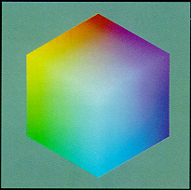
Example for RGB Color Model for CRT Displays
CRT displays have three phosphors (RGB) which produce a combination of wavelengths when excited with electrons.

Slide 120
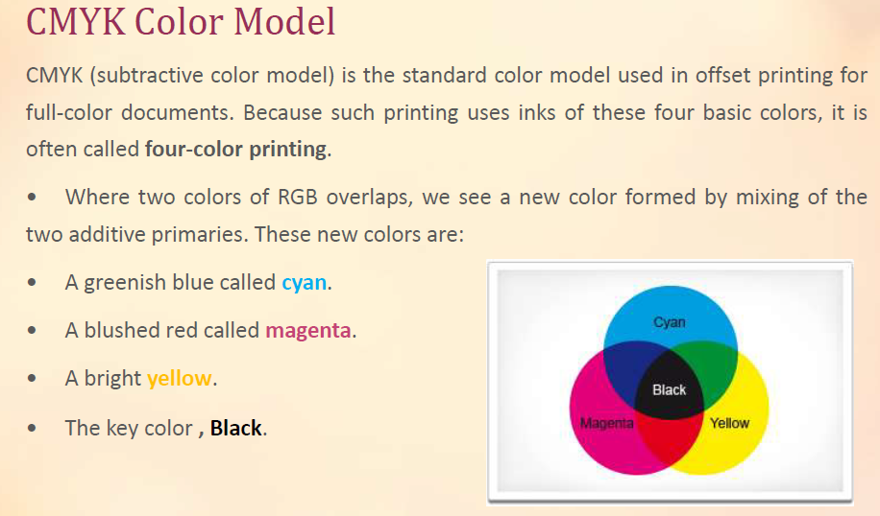

Slide 121
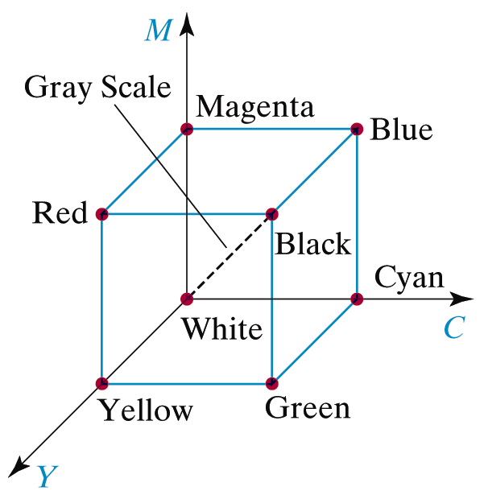

CMY Color Models
Color models for hard-copy devices, such as printers
Produce a color picture by coating a paper with color pigments
Obtain color patterns on the paper by reflected light, which is a subtractive process
The CMY parameters
A subtractive color model can be formed with the primary colors cyan, magenta and yellow
Unit cube representation for the CMY model with white at origin

Slide 122
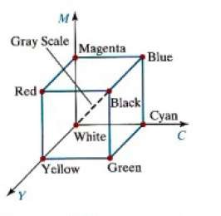
CMY Model
Used for hardcopy devices (ex. Printers).
A printed color that looks red absorbs the other two components G and B and reflects R.
Thus the C-M-Y coordinates are just the complements of the R-G-B coordinates.

Slide 123
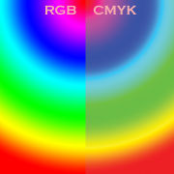
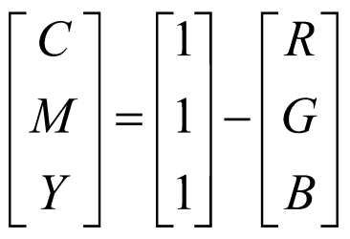

The CMY Color Models
Transformation between RGB and CMY color spaces
Transformation matrix of conversion from RGB to CMY
Transformation matrix of conversion from CMY to RGB

Slide 124
CMYK Model
Alternative CMYK model (K stands for Black) is used in color printing
(e.g., to produce darker black than simply mixing CMY).
K := min (C, M, Y),
C := C - K,
M := M - K,
Y := Y - K.
K used instead of equal amounts of CMY
called under color removal
richer black
less ink deposited on paper – dries more quickly

Slide 125


Slide 126
ILLUMINATION MODELS

Slide 127
Basic Illumination Model
Discussion about how object will illuminate?
An object is illuminated from the ambient light and from interrelated light source.
The important components are:
Ambient light (light coming from the nearby objects after reflection).
Diffuse Illumination
Specular reflection
Object Illuminates on the basis on following properties:
Intensity of Ambient Light
Type of Object surface
Surface color
Points to Remember:
In illumination & shading we try to develop models which are close approximation of real
world objects.
Models developed with the inclusion of illumination and shading concept should not be true virtual but it should be very close approximation of realistic scene.

Slide 128
Illumination Model
A real world image taken by digital camera will only capture a small subset of the light rays passing through a small area.
Often a approximation view is generated using complex formulation and algorithms.

Slide 129
Hardness of illumination model
A object is illuminated not only be direct light source but also from the light which is inter reflected from near by objects.
There can be infinite number of lights rays coming from the near by objects to illuminate the object.
In Illumination model it is very hard to find out all the inter reflected lights.
To make database for these lights rays is not possible.
Hence the image created after considering illumination model is only close approximation of original image.
In Illumination model we try to capture a set of light rays which reflected of inter reflected from the various objects so that a close approximation of original scene can be created.
Hence to get actual reality of scenes is not possible.

Slide 130

Illumination model
Figure 13 shows the specular reflection direction at a point on
N
the illuminated surface. In this figure,
To Light Source
L
R
represents the unit vector in
the direction of specular reflection;
L – unit vector directed toward the point light source;
θ
θ
Φ
V
Fig. 13
Modeling specular reflection.
V – unit vector pointing to the viewer from the surface position.
Angle Φ is the viewing angle relative to the specular- reflection direction R.
Viewing direction can be any where in 3D plane.
5

Slide 131


Illumination Model
Multiple viewing direction in 3D scene.
A light source may come from various direction
1. Due to more than one light source
2. Due to inter reflection of light from various
objects present in the scene.

Slide 132



Ambient Light
A surface that is not exposed to direct light may still be lit up by reflections from other nearby objects – ambient light.

Slide 133
Surface Lighting Effects
The amount of incident light reflected by a surface depends on the type of material.
Shiny materials reflect more of the incident light and dull surfaces absorb more of the incident light.
For transparent surfaces some of the light is also transmitted through the material.

Slide 134

Diffuse Reflection/Perfect Diffuse Reflection
Surfaces that are rough or grainy tend to reflect light in all directions.
This scattered light is called diffuse reflection.
Surfaces that reflect incident light with equal intensity in all directions. It is a case of perfect diffuse reflection.
Such surfaces are referred to as ideal diffuse reflectors.
Example- snow, movie screen.
Lambertian surface appears equally bright from all the viewing directions. Because they reflect light with equal intensity in all direction.

Slide 135

Specular Reflection (contd…)
A perfect mirror reflects light only in the specular-reflection direction.
Other objects exhibit specular reflections over a finite range of viewing positions around vector R.
N
To Light Source
R
L
θ
θ
V
Φ
Fig. 13
Modeling specular reflection.

Slide 136
Specular Reflection
In Specular reflection it may possible that some portion of surface generated more light or may produce bright spot.
This is called specular reflection.

Slide 137
Example of Specular Reflection
Metal surfaces
Mirror
Shiny plastic
Gold and silver coated surfaces
Shiny apple surface

Slide 138

Specular Reflection

Slide 139

Example

Slide 140
Basic illumination model
Phong model: empirical model for specular reflection
N
L
R
V
θ
θ
φ

Slide 141
Basic illumination model
Phong model: empirical model for specular reflection
N
L
R
V
θ
θ
φ
H&B 17-3:537-546

Slide 142
Basic illumination model
Phong model: calculating the vectors
L
L
N
R
V
N.L
H&B 17-3:537-546

Slide 143
Basic illumination model
Phong model: variant with halfway vector H.
Use α instead of φ.
N
H
L
R
α
V
φ
If light source and viewer far away:
H ± constant.
H&B 17-3:537-546

Slide 144
Basic illumination model
All together:
H&B 17-3:537-546

Slide 145

Q.Explain Cohen Sutherland line clipping, clip the lines with coordinates (x0,y0)=(60,20) and (x1,y1) =(80,120) given the window boundaries( xwmin,ywmin)=(50,50) and (xmax, ymax) = (100,100)

Slide 146



Slide 147
Thank You!!

